Slide 1

OSS Tools for System Management
Sanjula Ganepola
Software Developer – IBM i App Dev & AI Toolchain
Sanjula.Ganepola@ibm.com
2025 February

Slide 2
Agenda
Current State of System Management on IBM i
Operational Monitoring with Prometheus
Data Visualization with Grafana
Event Monitoring with Manzan
Manzan + AI

Slide 3
Current State of System Management on IBM i

Slide 4
What tools are you using to monitor your IBM i systems?
Choose up to 3:
Dynatrace
Nagios
Instana
DataDog
Control4i
Syslog Reporting Manager (SRM)
Created your own
Other

Slide 5
Specialty is a collective disadvantage
Dynatrace
Nagios
Instana
DataDog
Control4i
Syslog Reporting Manager (SRM)
Created your own
Other
Each solutions may have their own…
Configuration
Host installation requirements
Monitoring capabilities
Collect system metrics (active jobs, ASP consumption)
View sub system information
Identify long-running SQL
View job queue
Can you integrate with other tools?

Slide 6
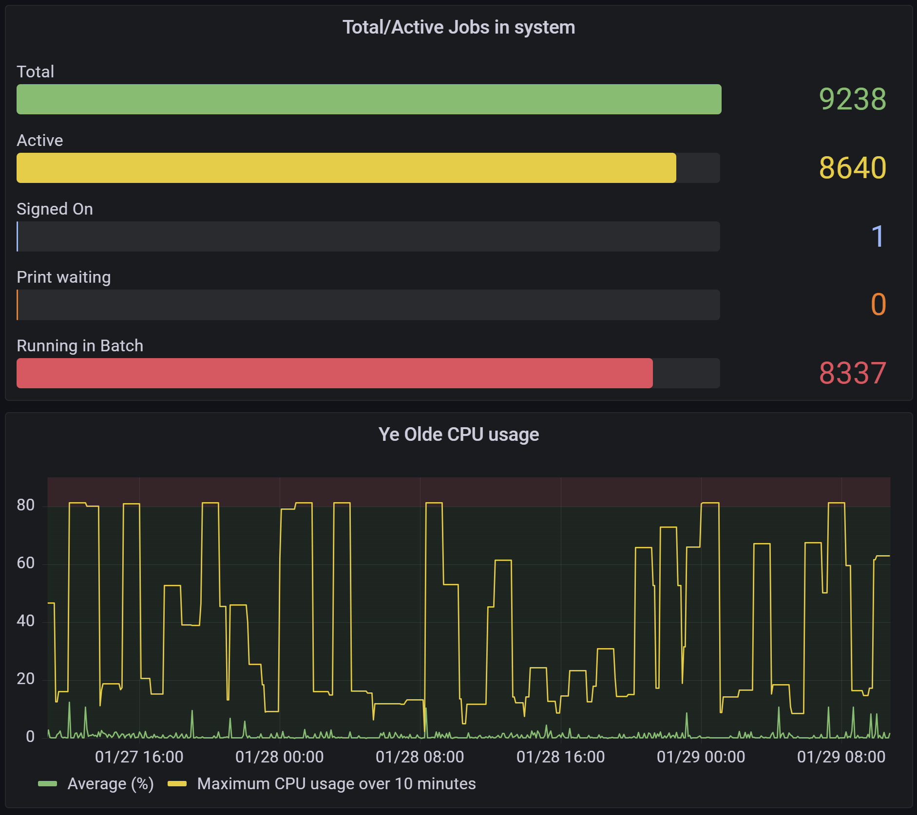
Do you use Grafana?
Choose 1:
Yes, with IBM i
Yes, but not with IBM i
No, but we want to
No, we don’t want to
No, don’t know what it is

Slide 7
Operational Monitoring with Prometheus

Slide 8

Prometheus Overview
What is it?
Leading open-source systems monitoring and alerting toolkit
Collects and stores metrics as timeseries data
Features
Multi-dimensional data model with time series data
Provides a functional query language called PromQL
No reliance on distributed storage
Has an alert manager built-in
Easily paired with Grafana and other monitoring solutions

Slide 9
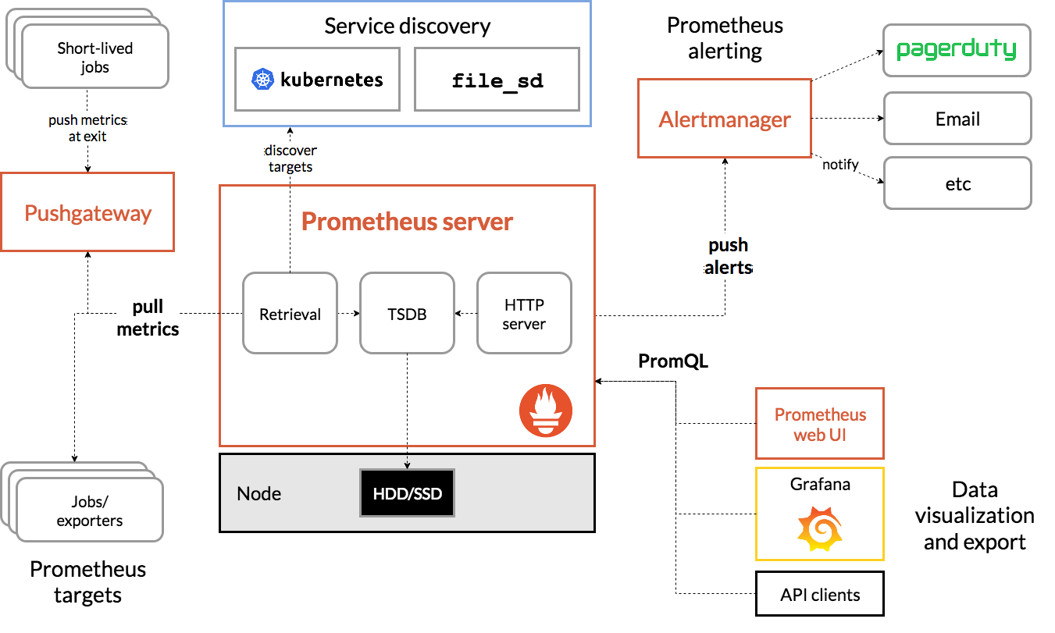
Prometheus Architecture

Slide 10

What do exporters do?
Collection of exporters: https://prometheus.io/docs/instrumenting/exporters/
Fetch metrics
Convert them to Prometheus format
Expose data via an HTTP endpoint for it to be scraped
Applications
Database
Host Machines
Containers
Pull metrics over HTTP

Slide 11
Data Model for TSDB
All data is stored as a time series: (timestamp, value)
Each time series has a name (metric name)
General feature of a system that is measured
Each time series can have key/value pairs (metric labels)
Identifies a particular dimension of the metric
Notation: <metric name>{<label name>=<label value>, ...}
api_http_requests_total{method="POST", endpoint="/messages"}
Time series is uniquely identified by metric name + metric label
temperature{city="Toronto"}
temperature{city="Rochester"}
Ordered by timestamp
Integer or fractional value

Slide 12
Understanding Time series Data
Prometheus Database
http_request_total | GET | /
1683000000 | 1
1683000020 | 2
1683000040 | 4
1683000060 | 1
1683000080 | 6
1683000100 | 2
1683000120 | 3
http_request_total | POST | /item
1683000000 | 26
1683000020 | 21
1683000040 | 14
1683000060 | 3
1683000080 | 28
1683000100 | 12
1683000120 | 22
http_request_total | PUT | /item
1683000000 | 4
1683000020 | 5
1683000040 | 6
1683000060 | 1
1683000080 | 2
1683000100 | 10
1683000120 | 7

Slide 13
PromQL 101 – Instant Vector
Prometheus Database
http_request_total | GET | /
1683000000 | 1
1683000020 | 2
1683000040 | 4
1683000060 | 1
1683000080 | 6
1683000100 | 2
1683000120 | 3
http_request_total | POST | /item
1683000000 | 26
1683000020 | 21
1683000040 | 14
1683000060 | 3
1683000080 | 28
1683000100 | 12
1683000120 | 22
http_request_total | PUT | /item
1683000000 | 4
1683000020 | 5
1683000040 | 6
1683000060 | 1
1683000080 | 2
1683000100 | 10
1683000120 | 7
🔎 http_request_total → http_request_total{method=“GET”, endpoint=“/”} 3
http_request_total{method=“POST”, endpoint=“/item”} 22
http_request_total{method=“PUT”, endpoint=“/item”} 7

Slide 14
PromQL 101 – @ modifier
Prometheus Database
http_request_total | GET | /
1683000000 | 1
1683000020 | 2
1683000040 | 4
1683000060 | 1
1683000080 | 6
1683000100 | 2
1683000120 | 3
http_request_total | POST | /item
1683000000 | 26
1683000020 | 21
1683000040 | 14
1683000060 | 3
1683000080 | 28
1683000100 | 12
1683000120 | 22
http_request_total | PUT | /item
1683000000 | 4
1683000020 | 5
1683000040 | 6
1683000060 | 1
1683000080 | 2
1683000100 | 10
1683000120 | 7
🔎 http_request_total@1683000040 → http_request_total{method=“GET”, endpoint=“/”} 4
http_request_total{method=“POST”, endpoint=“/item”} 14
http_request_total{method=“PUT”, endpoint=“/item”} 6

Slide 15
PromQL 101 – Label Selection
Prometheus Database
http_request_total | GET | /
1683000000 | 1
1683000020 | 2
1683000040 | 4
1683000060 | 1
1683000080 | 6
1683000100 | 2
1683000120 | 3
http_request_total | POST | /item
1683000000 | 26
1683000020 | 21
1683000040 | 14
1683000060 | 3
1683000080 | 28
1683000100 | 12
1683000120 | 22
http_request_total | PUT | /item
1683000000 | 4
1683000020 | 5
1683000040 | 6
1683000060 | 1
1683000080 | 2
1683000100 | 10
1683000120 | 7
🔎 http_request_total{endpoint=“/item”} → http_request_total{method=“POST”, endpoint=“/item”} 22
http_request_total{method=“PUT”, endpoint=“/item”} 7

Slide 16
PromQL 101 – Range Vectors
Prometheus Database
http_request_total | GET | /
1683000000 | 1
1683000020 | 2
1683000040 | 4
1683000060 | 1
1683000080 | 6
1683000100 | 2
1683000120 | 3
http_request_total | POST | /item
1683000000 | 26
1683000020 | 21
1683000040 | 14
1683000060 | 3
1683000080 | 28
1683000100 | 12
1683000120 | 22
http_request_total | PUT | /item
1683000000 | 4
1683000020 | 5
1683000040 | 6
1683000060 | 1
1683000080 | 2
1683000100 | 10
1683000120 | 7
🔎 http_request_total{method=“GET”}[30s] → http_request_total{method=“GET”, endpoint=“/”} 2@1683000100
3@1683000120

Slide 17

How to use Prometheus with IBM i

Slide 18
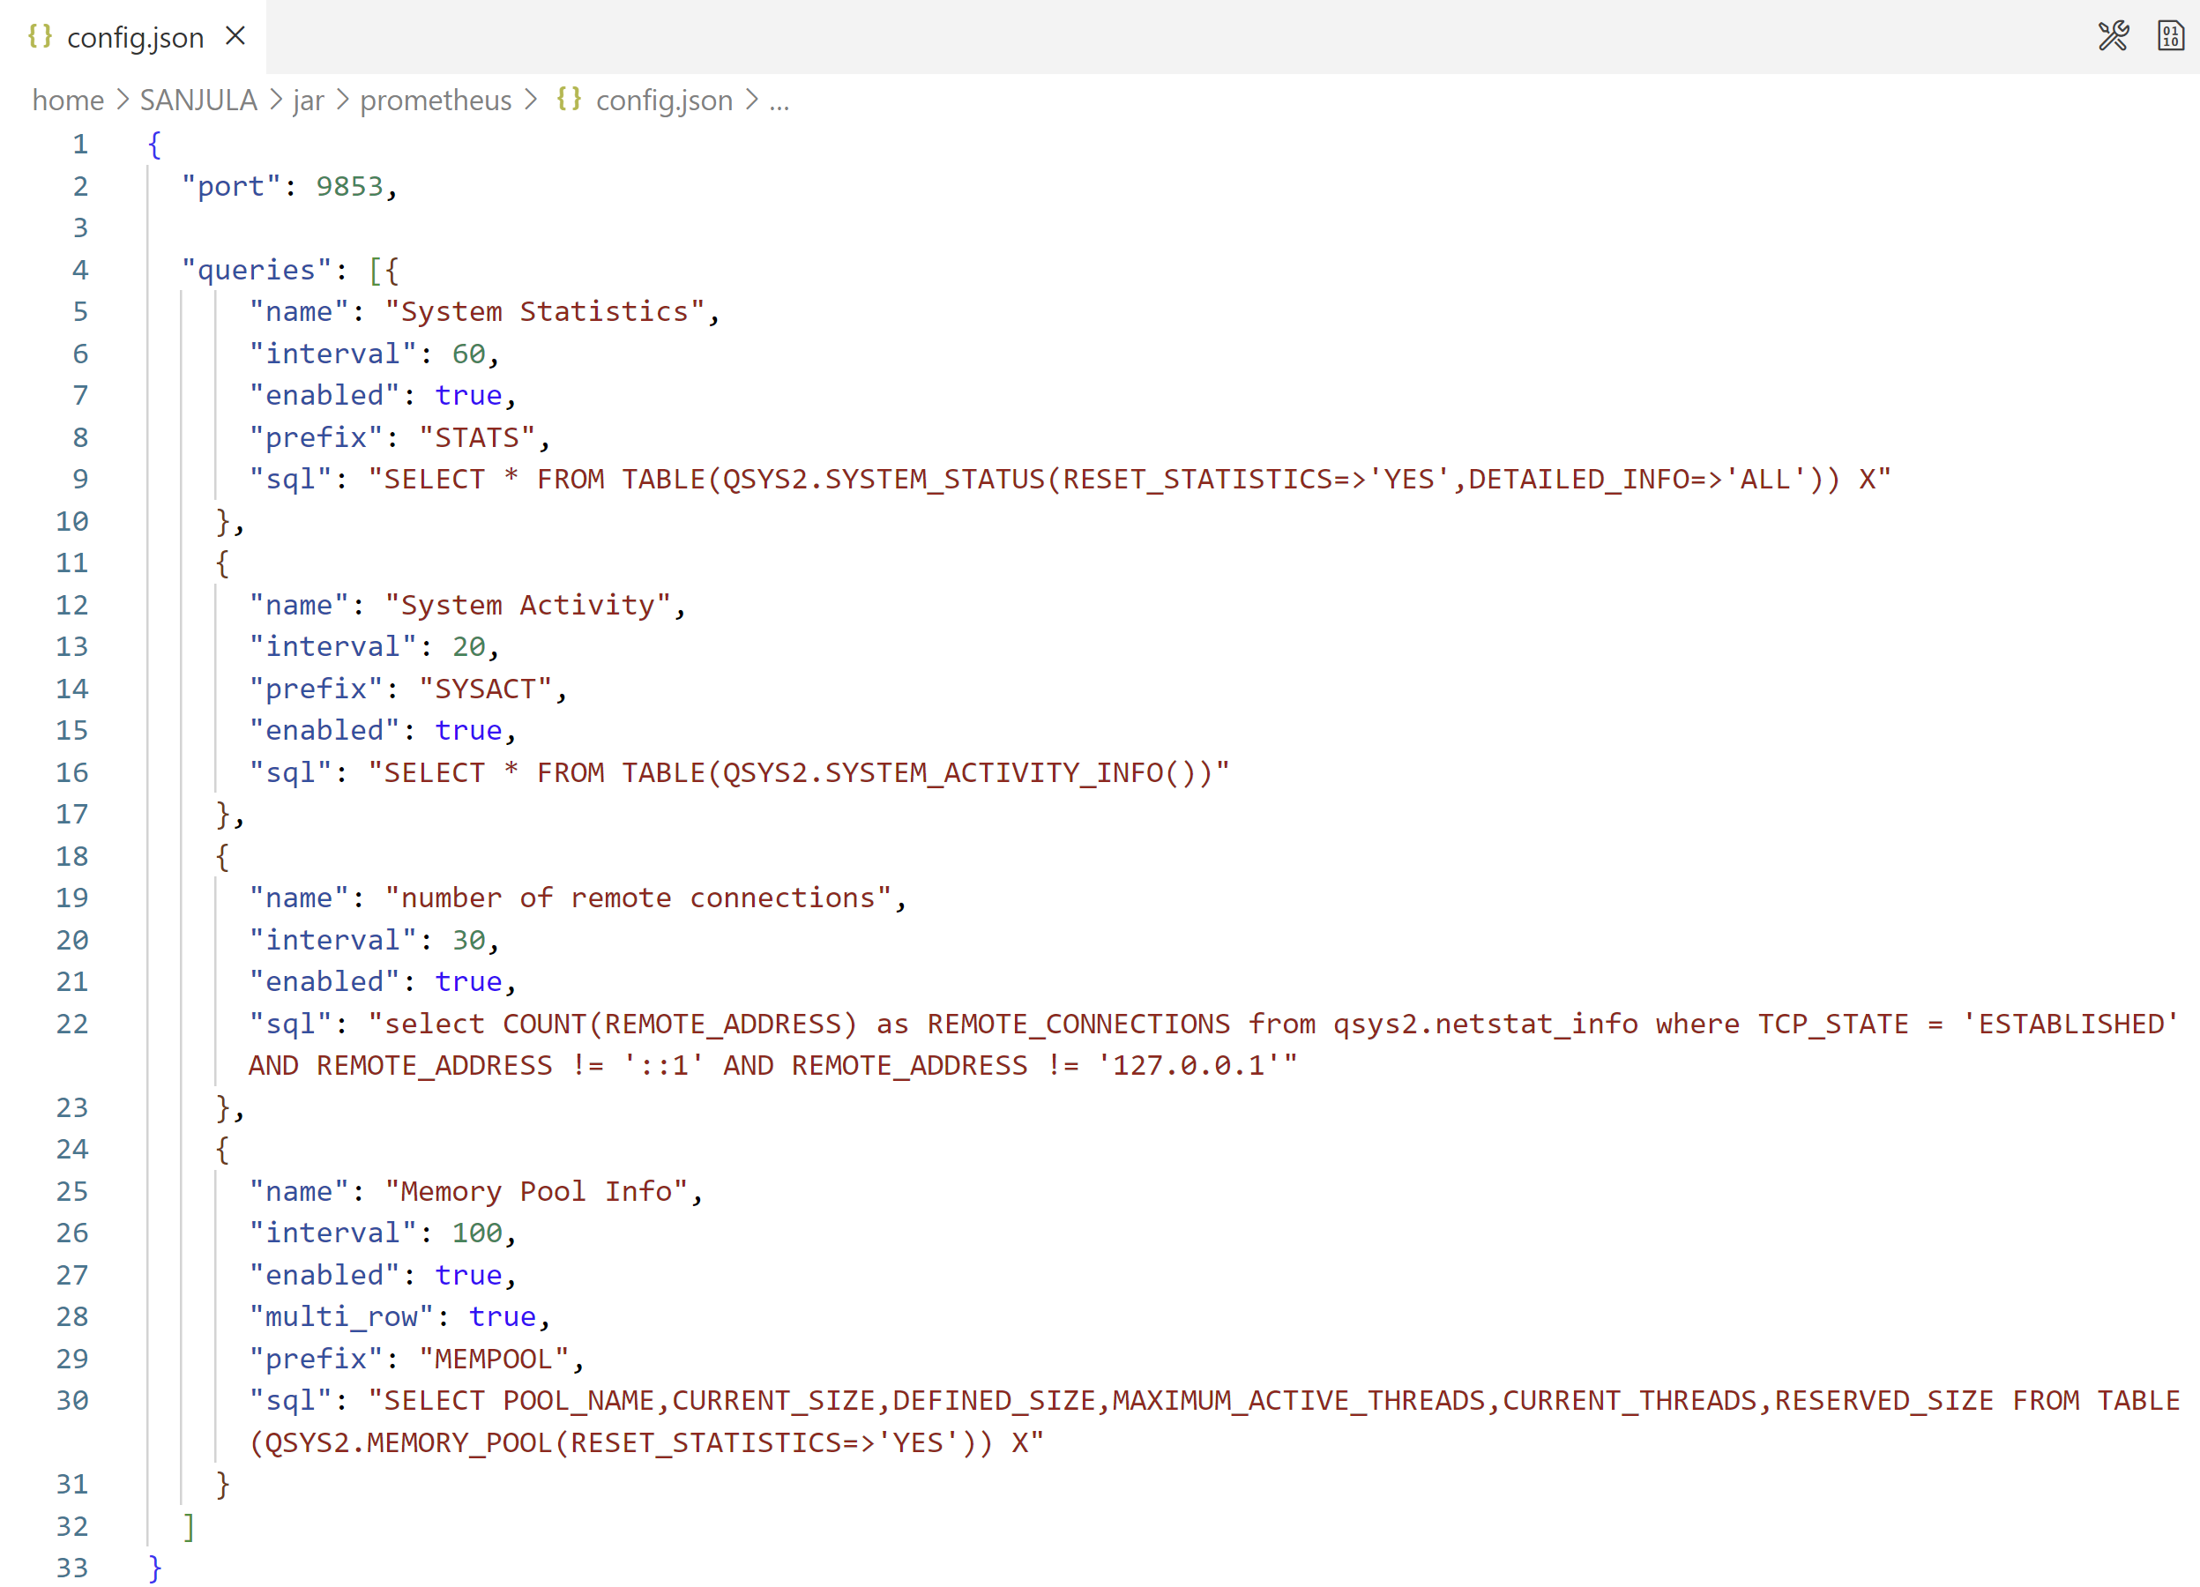
IBM i Prometheus Exporter
JDBC-based exporter that leverages SQL to export IBM i metrics
Exports hundreds of metrics including:
System activity levels (such as CPU usage)
Memory pool information
Apache HTTP server metrics
Number of remote TCP connections
User customizable metrics with SQL
https://github.com/ThePrez/prometheus-exporter-jdbc

Slide 19
Deploying the IBM i Prometheus Exporter
Video Demo: https://www.youtube.com/watch?v=qIcAx4lJZIA
1. Download latest .jar file from release page and store in the IFS:
wget https://github.com/ThePrez/prometheus-exporter-jdbc/releases/latest/download/prom-client-ibmi.jar
2. If this is your first time, create a default configuration file (config.json):
java -jar prom-client-ibmi.jar
3. Respond with y for the following message:
Configuration file config.json not found. Would you like to initialize one with defaults? [y]
4. Confirm the Prometheus client has started:
==============================================================
Successfully started Prometheus client on port 9853 ==============================================================
5. Create a service commander configuration file (prometheus.yml) and start it:
java -jar prom-client-ibmi.jar sc
sc start prometheus.yml

Slide 20
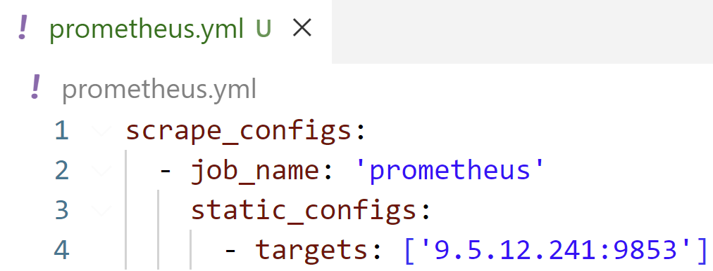
Deploying the Prometheus Instance
1. Download the Prometheus-provided image from Docker Hub to some central location:
docker pull prom/prometheus
or
podman pull docker.io/prom/prometheus
2. Create a Prometheus configuration file (prometheus.yml):
3. Launch the image in a container named “prometheus”:
docker run -d --name=prometheus -v /path/to/prometheus.yml:/etc/prometheus/prometheus.yml -p 9090:9090 prom/prometheus
or
podman run -d --name=prometheus -v /path/to/prometheus.yml:/etc/prometheus/prometheus.yml -p 9090:9090 prom/prometheus
4. Navigate to Prometheus web UI at http://<container_ip>:9090

Slide 21
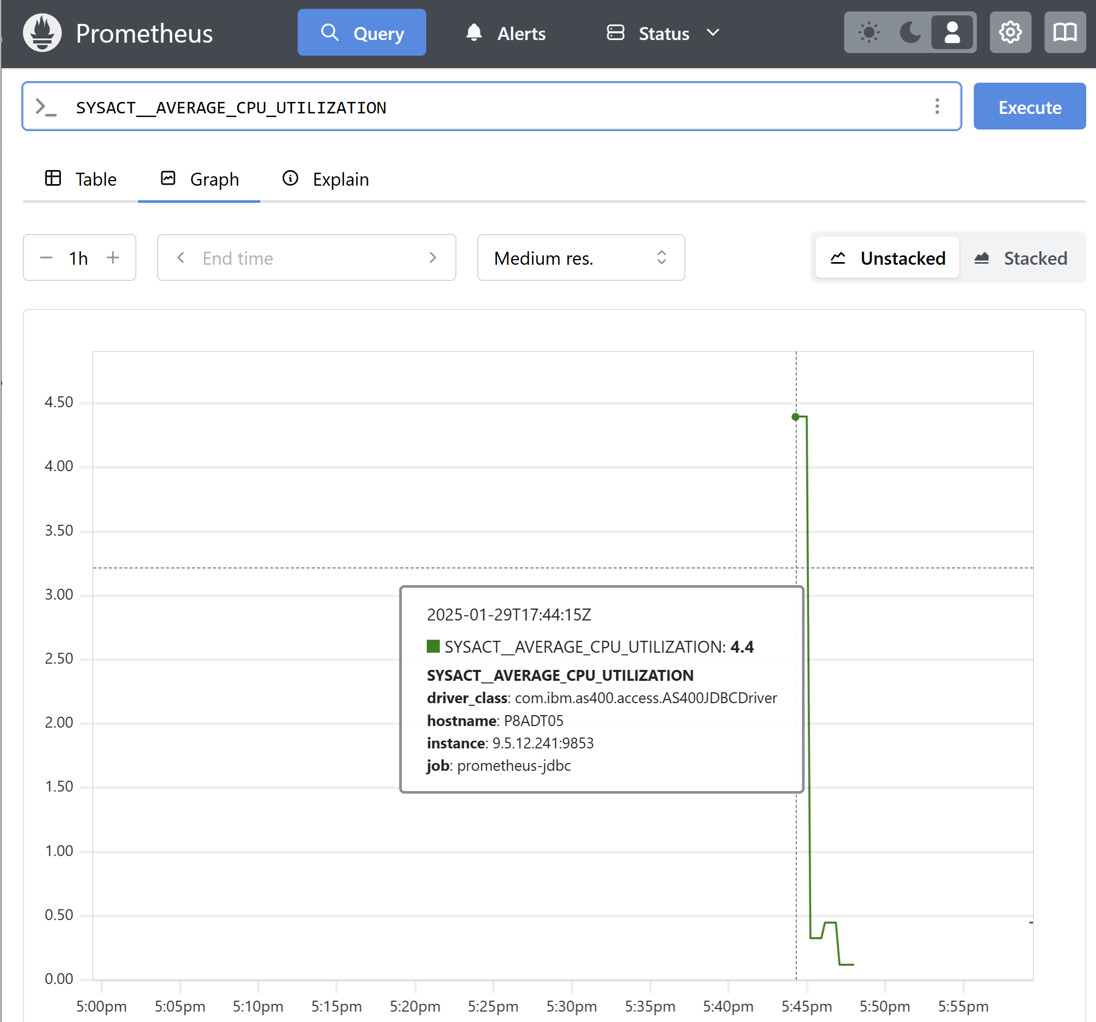
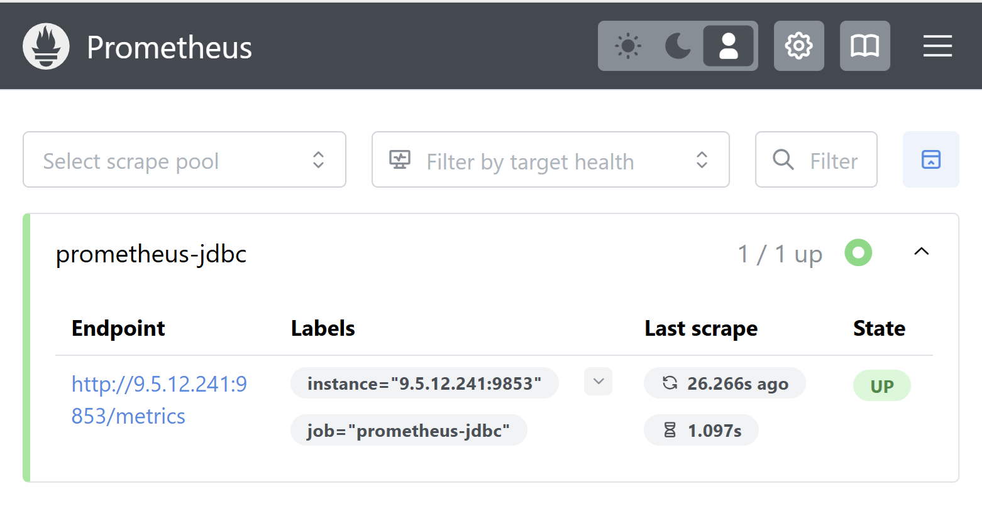
Prometheus Web UI
Graphing Historical Metric Data
Target System Status
Blog post by Jesse Gorzinski: "Monitoring IBM i with Prometheus"
https://techchannel.com/open-source-on-ibm-i/monitoring-ibm-i-with-prometheus/

Slide 22








Prometheus can be the bridge to other solutions

Slide 23
Data Visualization with Grafana

Slide 24
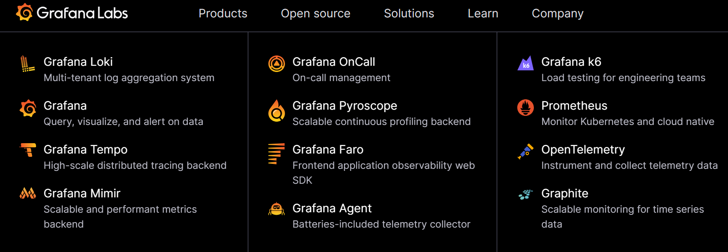
Grafana Overview
Open-source analytics, visualization, and monitoring solution
Driven by Grafana Labs. Plenty of open-source components. See https://grafana.com/
Over 300 plugins available

Slide 25
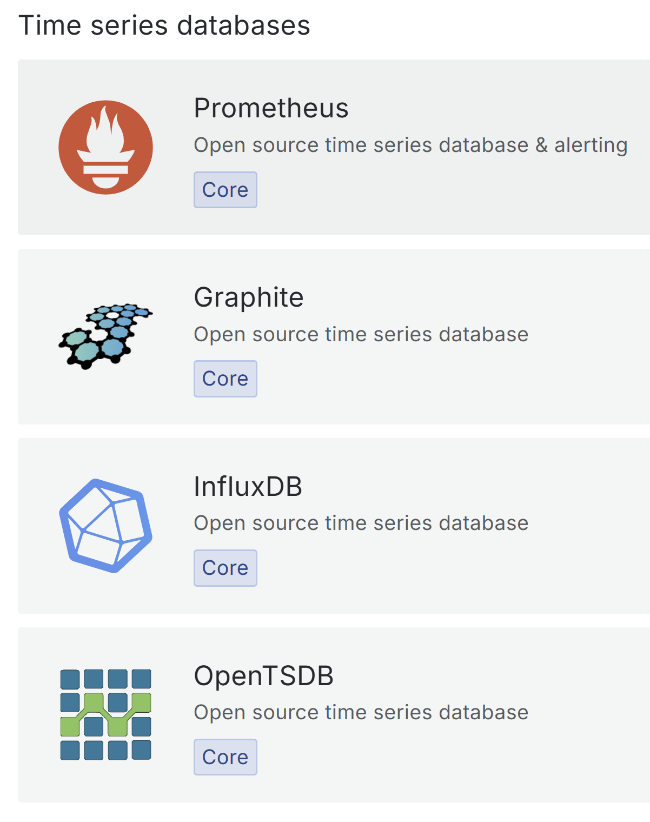
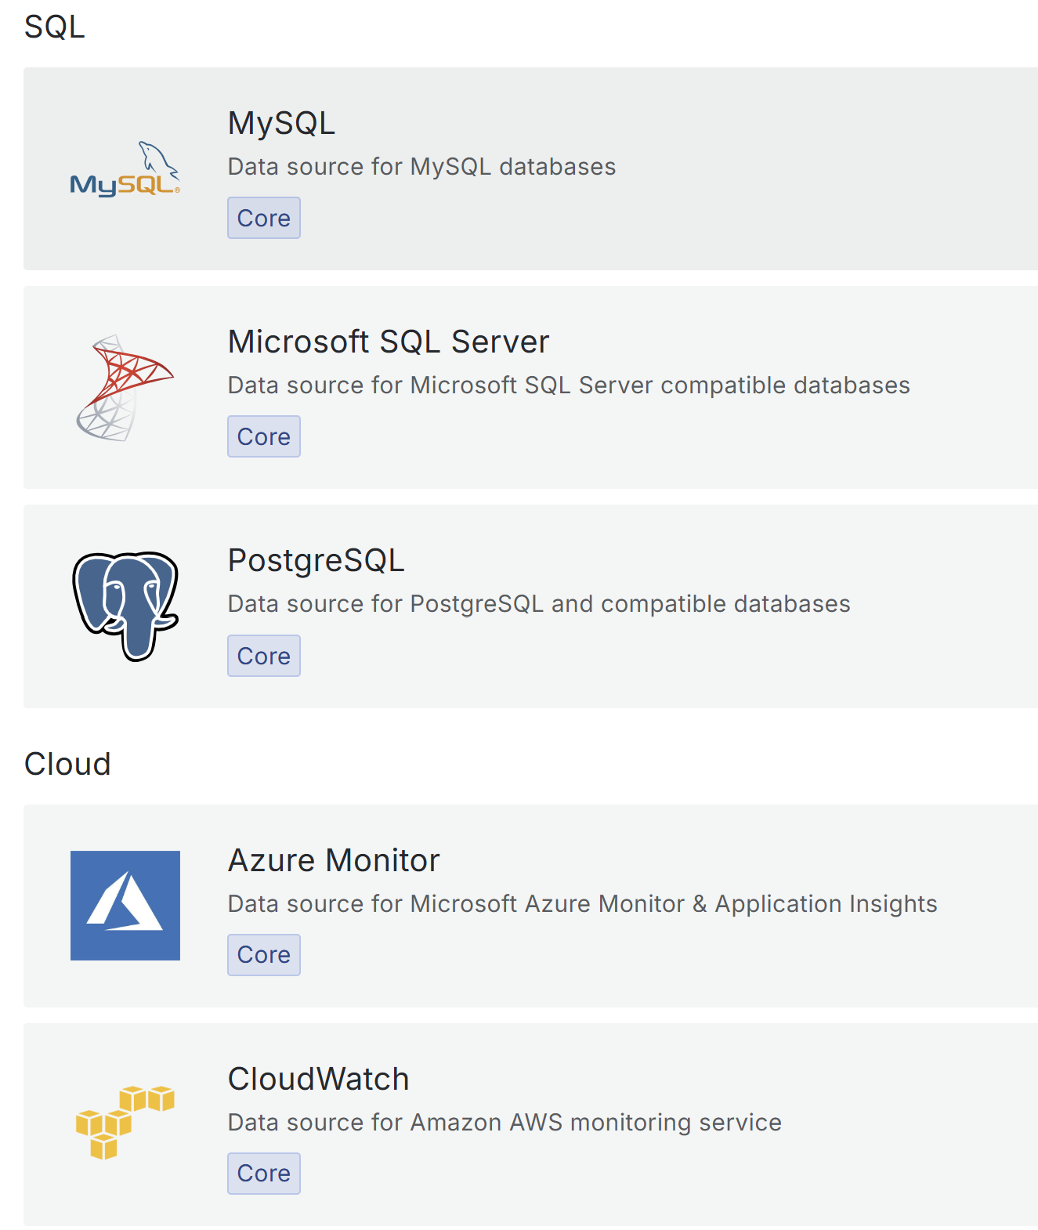
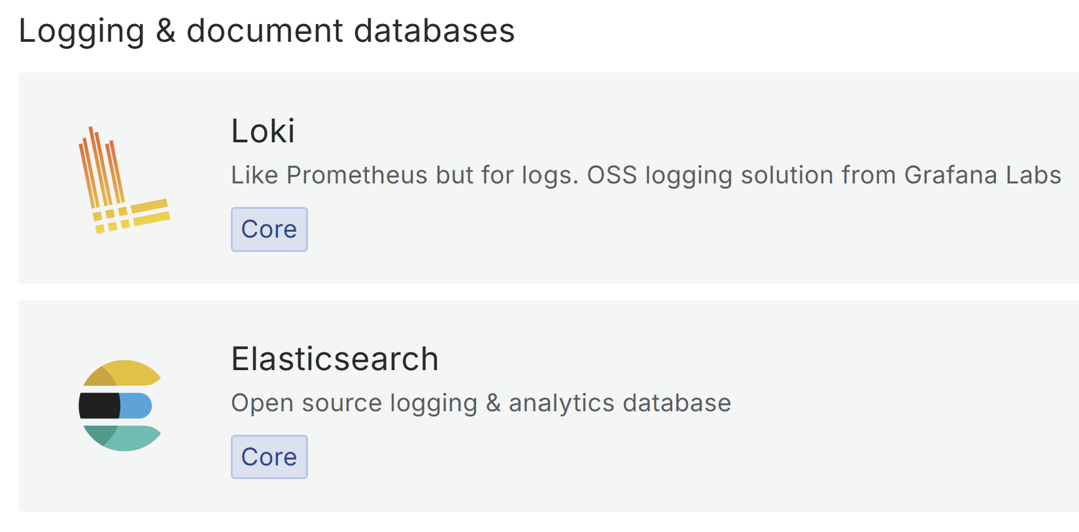
Grafana Data Sources

Slide 26
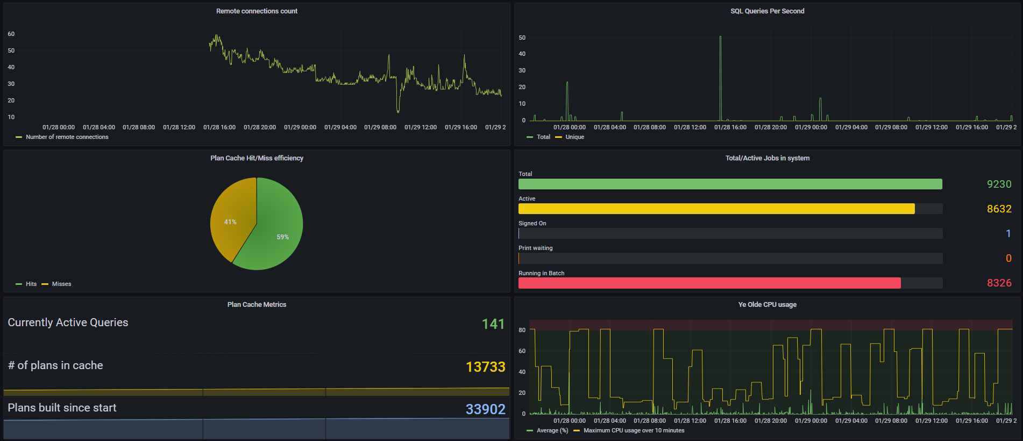
Prometheus Visualization with Grafana
Public COMMON1 Grafana Dashboard: http://ibm.biz/ibmi-prometheus

Slide 27
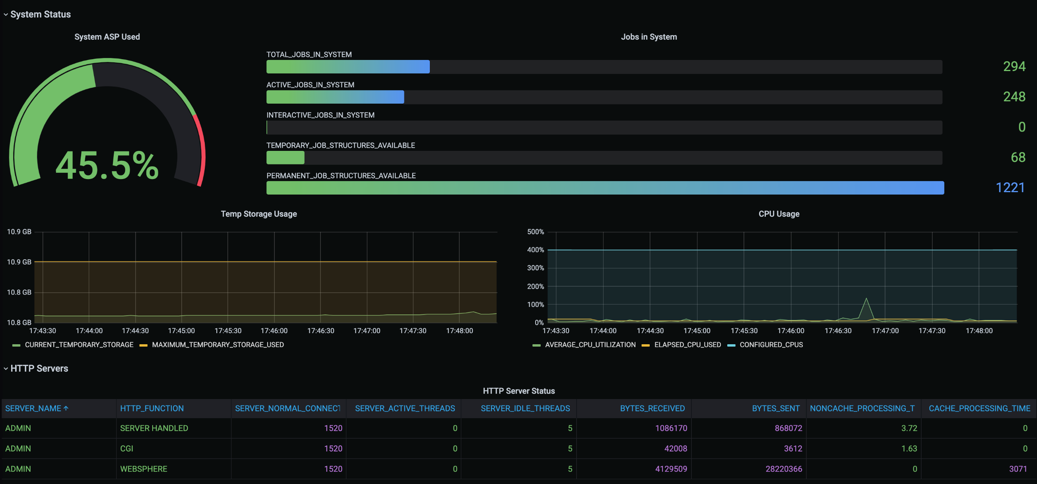
Grafana Backend (Without Prometheus)
Blog post by Jesse Gorzinski: "How to Deploy a Simple Grafana Dashboard“ https://techchannel.com/performance/how-to-deploy-a-simple-grafana-dashboard/

Slide 28
Grafana with or without Prometheus
 | With Prometheus | Straight to Grafana
Persistent storage | Prometheus | Grafana
Persistent storage of unused metrics | Prometheus | --
Metric type | Numerics | Numerics/strings/other
Ecosystem | Extremely Broad | There
Scalability | Excellent | Good
IBM i requisites | None | Node.js
Initial setup | Easier | Easy

Slide 29
Event Monitoring with Manzan

Slide 30
Manzan Overview
Open-source event handling tool designed to simplify handling of system events
Serves as a gateway for publishing IBM i events to a variety of endpoints:
User applications
External resources
Open-source technologies
Example use cases:
Monitor system events with a third-party open source or proprietary tool
Consolidate logs for auditing/reporting + query for system events
Feed real-time system event data into stream processing systems (such as Apache Kafka)
Send alerts for system events
Full Documentation: https://theprez.github.io/Manzan/#/

Slide 31
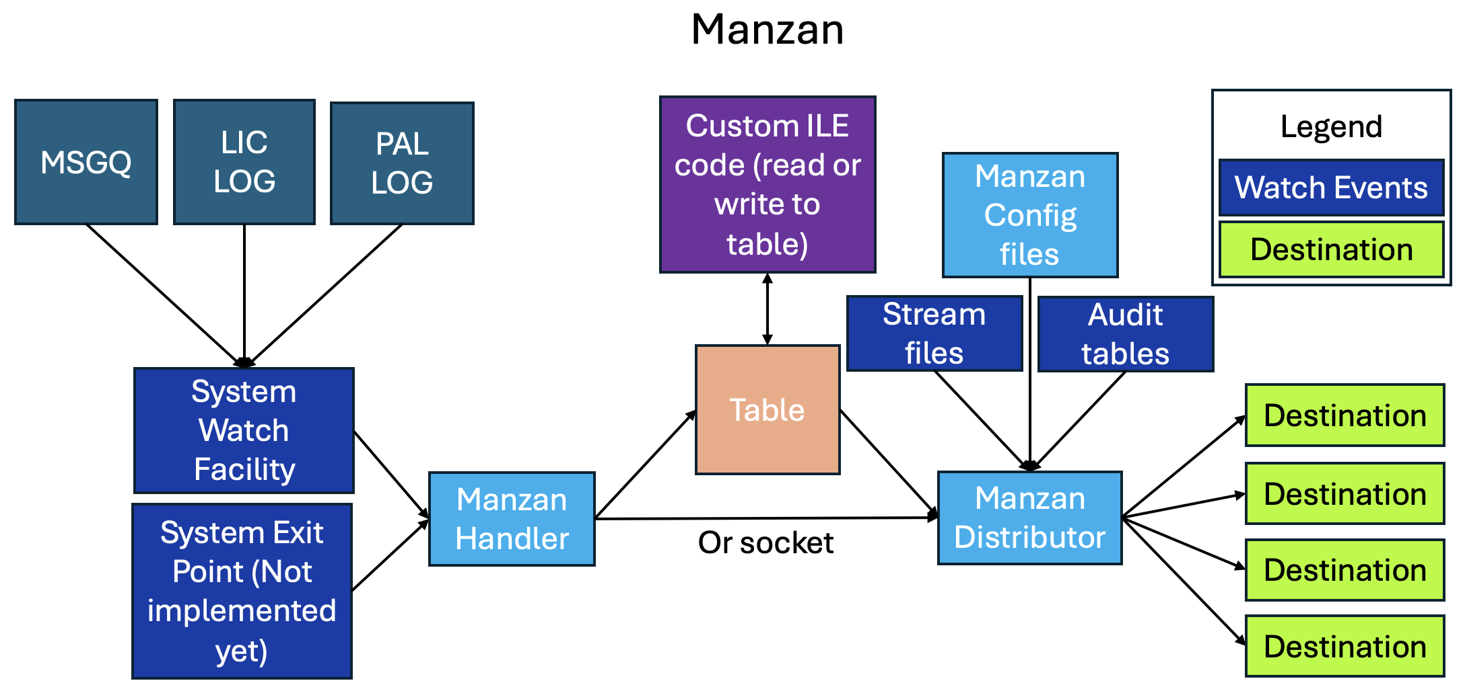
Understanding the Architecture

Slide 32
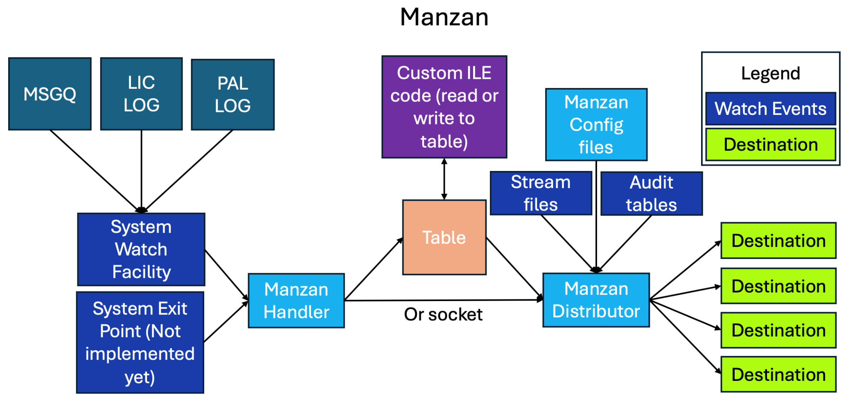
What are inputs?
Inputs: Sources of your data
Stream file
System watch facility (STRWCH)
MSGQ
LIC logs
PAL logs
SQL Tables
Audit journals
System exit points (coming soon)

Slide 33
So practically what can Manzan monitor?
Application crashes
History Log entries
Log data
Specific entries in log data
System Limits alerts
Problem log entries
*SYSOPR messages
Specific job log messages
Audit journal events (future)
PAL entries
Fishy TCP connections (future)
VLOGs

Slide 34

What are destinations?
Destinations: Locations to send data
Built-in supported destinations:
HTTP/HTTPS endpoints (REST, etc.)
Email (SMTP/SMTPS)
SMS (via Twilio)
Slack
FluentD
Kafka
Sentry
Grafana Loki
Google Pub/Sub
ActiveMQ
Custom ILE Code

Slide 35
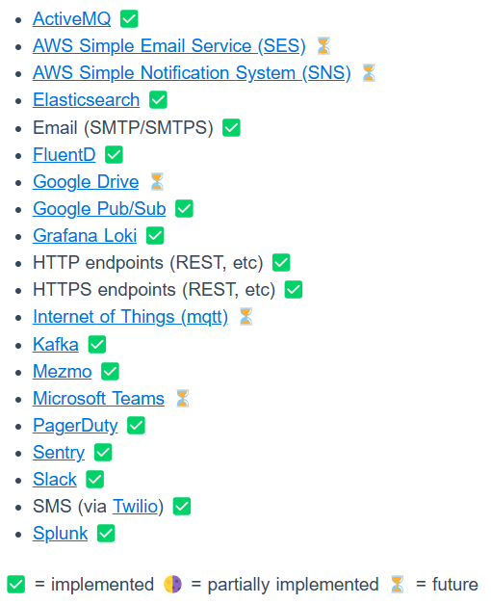
Can Manzan send data anywhere?
Many destinations are already working, but there are more to come
Track supported destinations: https://theprez.github.io/Manzan/#/?id=where-can-i-send-these-events
Desired target not on the list? Please open an issue to the repository and let us know!

Slide 36
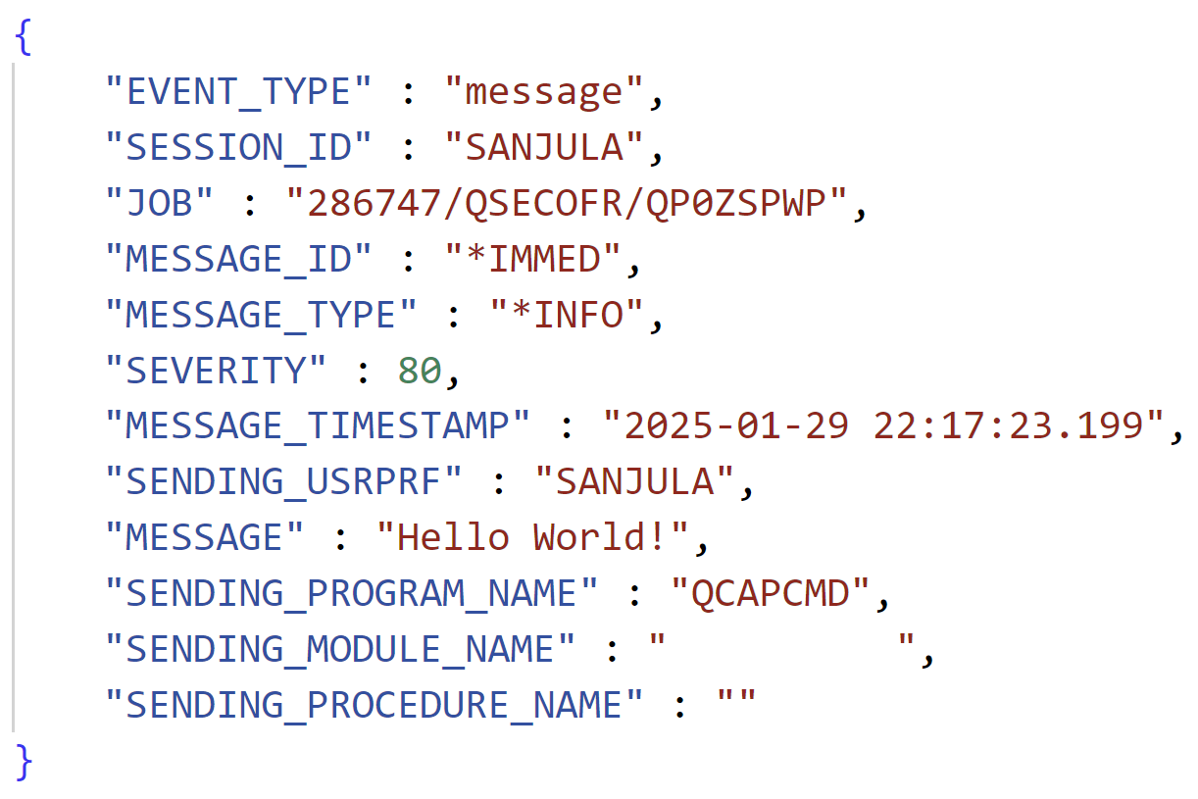
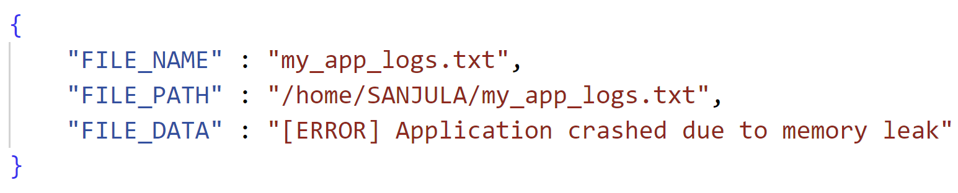
Understanding the Architecture: Handler and Distributor
Handler
Start system watches based on config files (data.ini)
Transform system event data into structured format
Add structured data to table or send over socket
Distributor
Fetch data off table or via socket
Send data to destinations using Apache Camel based on config files (dests.ini)
Data From Message Queue
Data From Stream File

Slide 37
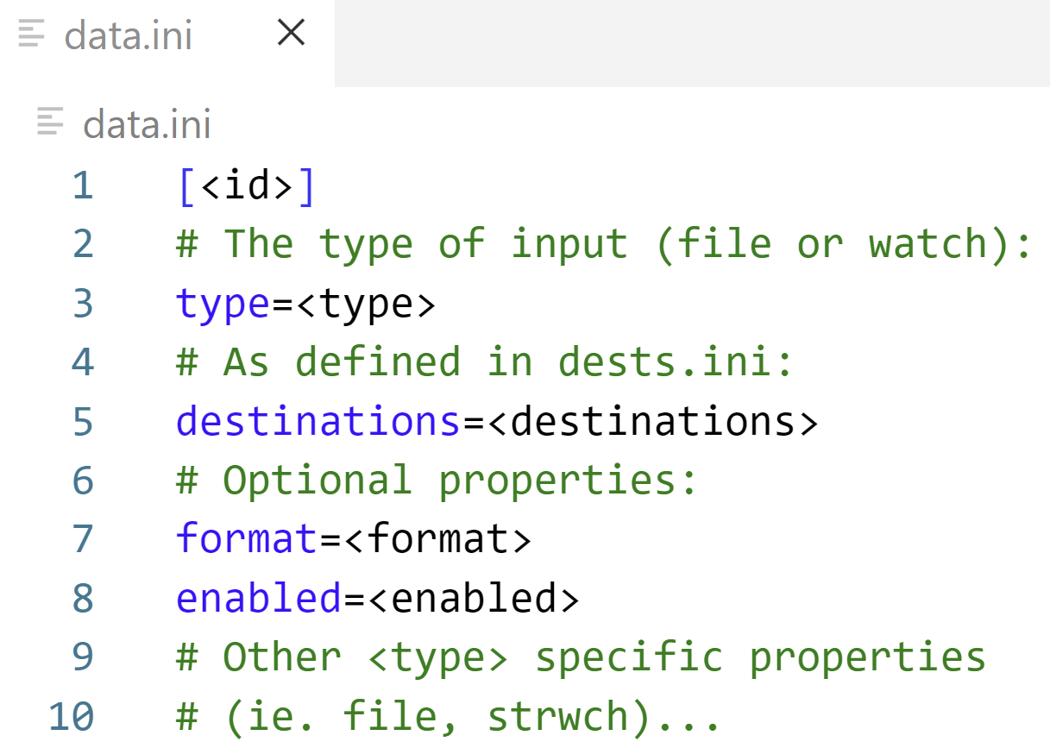
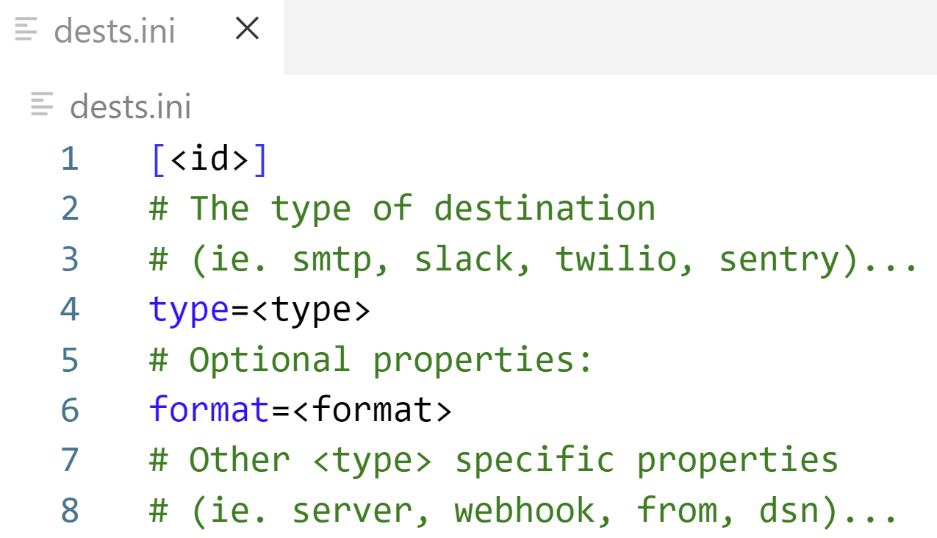
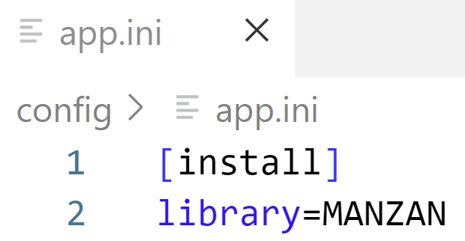
Configuring Inputs and Destinations
Configuration files are stored in /QOpenSys/etc/manzan
app.ini
data.ini
dests.ini
Used for general Manzan configuration (leave the default contents)
Used for configuring different inputs
Used for configuring different destinations

Slide 38
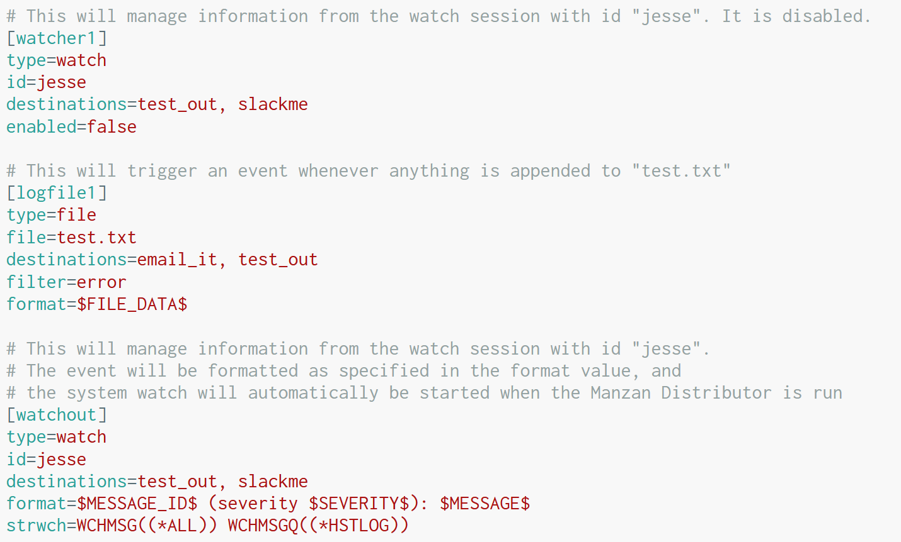
Simple data.ini configurations
Stream File
Watch application log file (test.txt) and only take action when a line written to the file contains the string “error”
System Watch
Manage information from watch session with id “jesse”

Slide 39
Advanced data.ini configuration
System Watch
Manage information from watch session with id “jesse” which watches all messages in the IBM i history log
Format the message into a human-sensible format

Slide 40
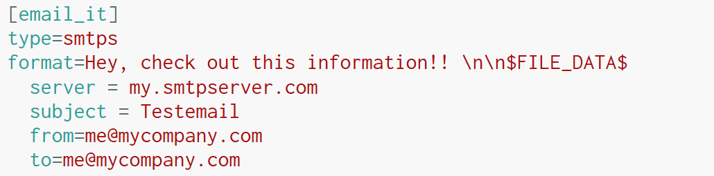
Example dests.ini configurations
Send to Manzan’s standard output
Send an email

Slide 41
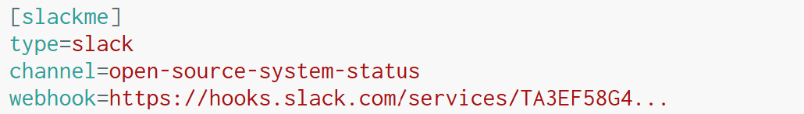
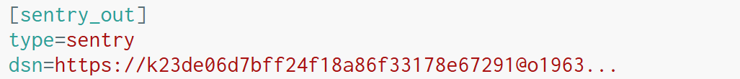
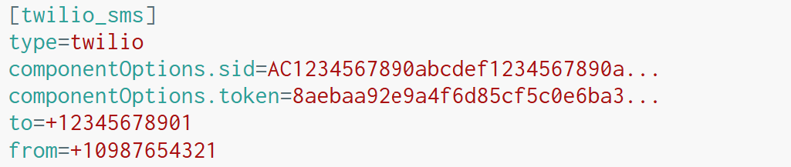
More example dests.ini configurations
Send message in Slack channel:
Send event to Sentry
Send SMS message with Twilio

Slide 42
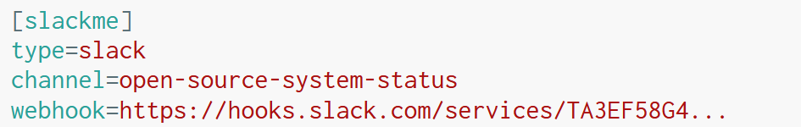
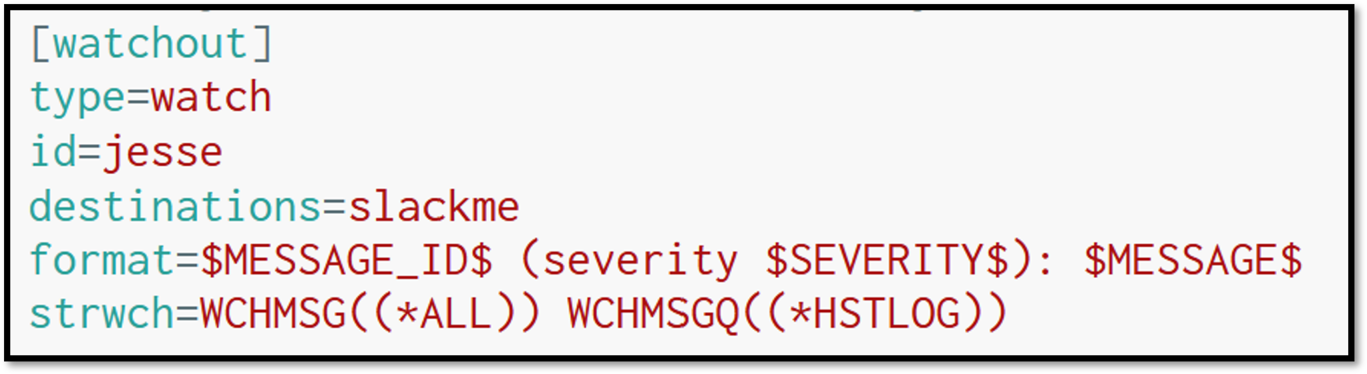
Let’s put it together…
dests.ini
data.ini

Slide 43
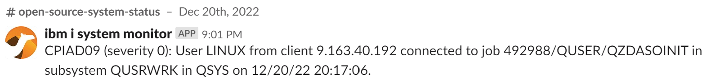
What does it look like in Slack?

Slide 44
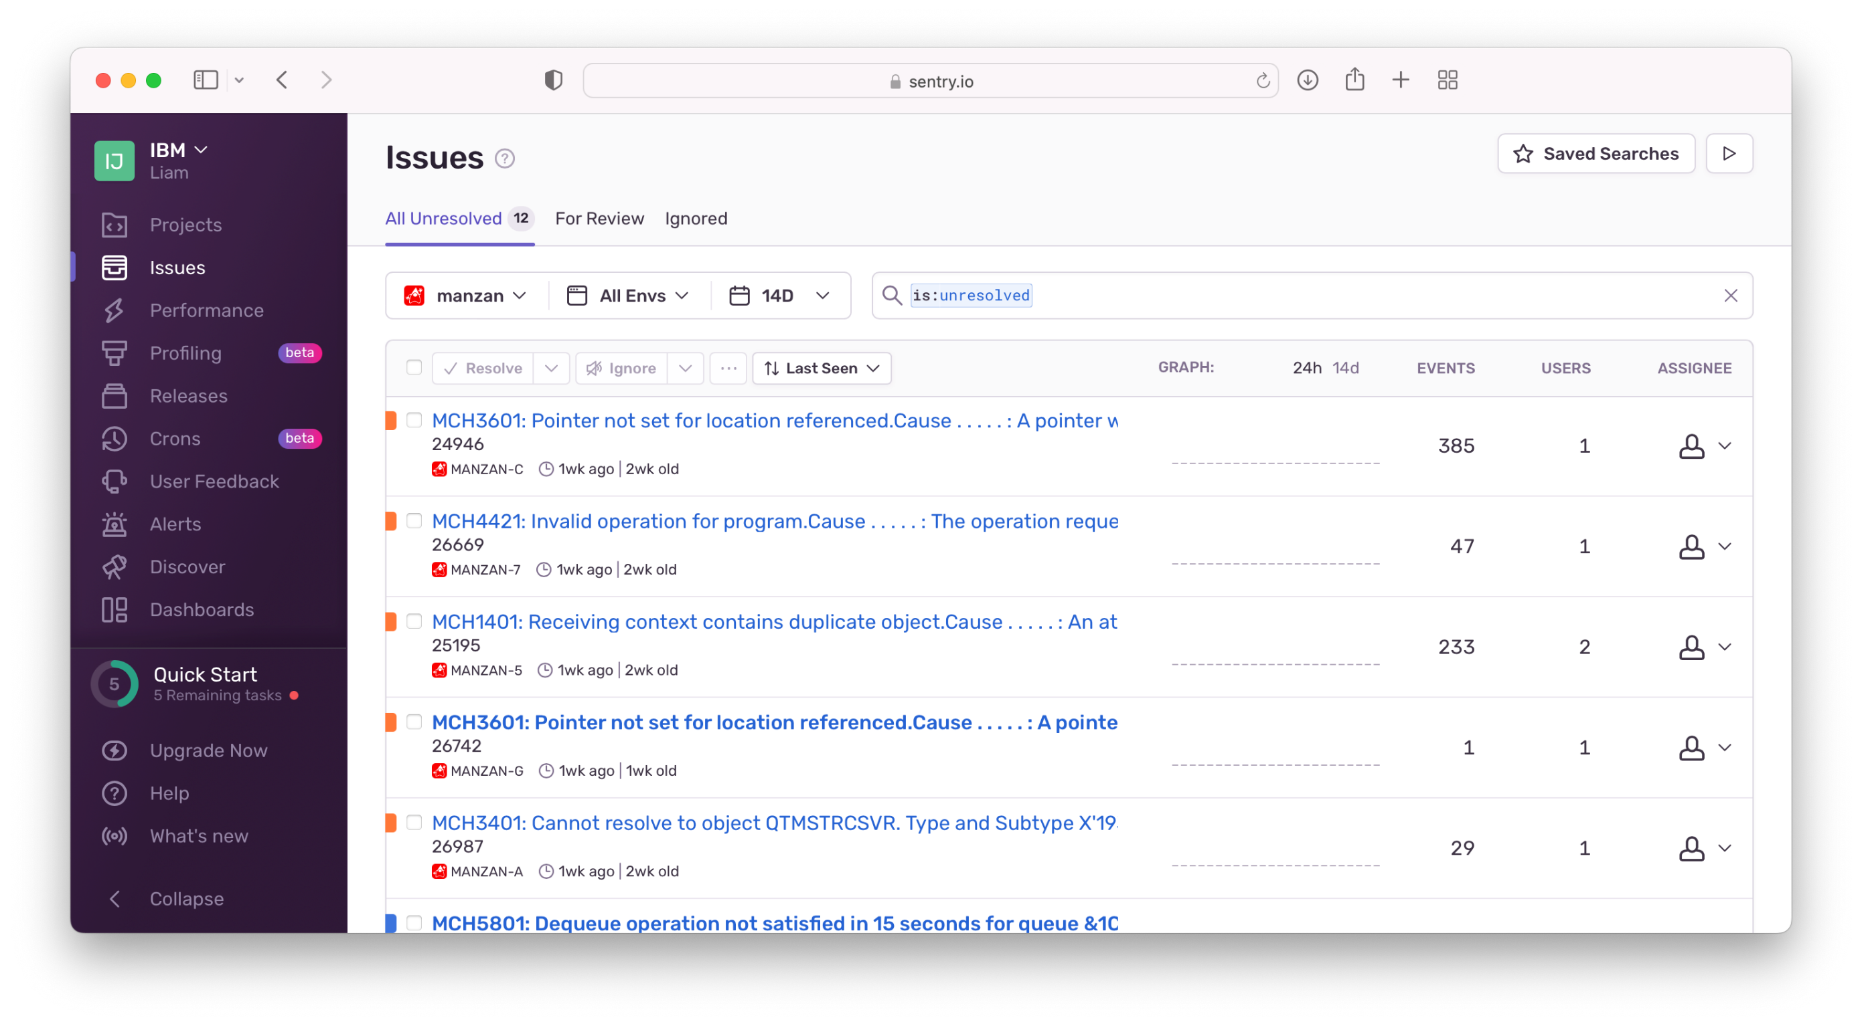
More examples…Sentry!

Slide 45
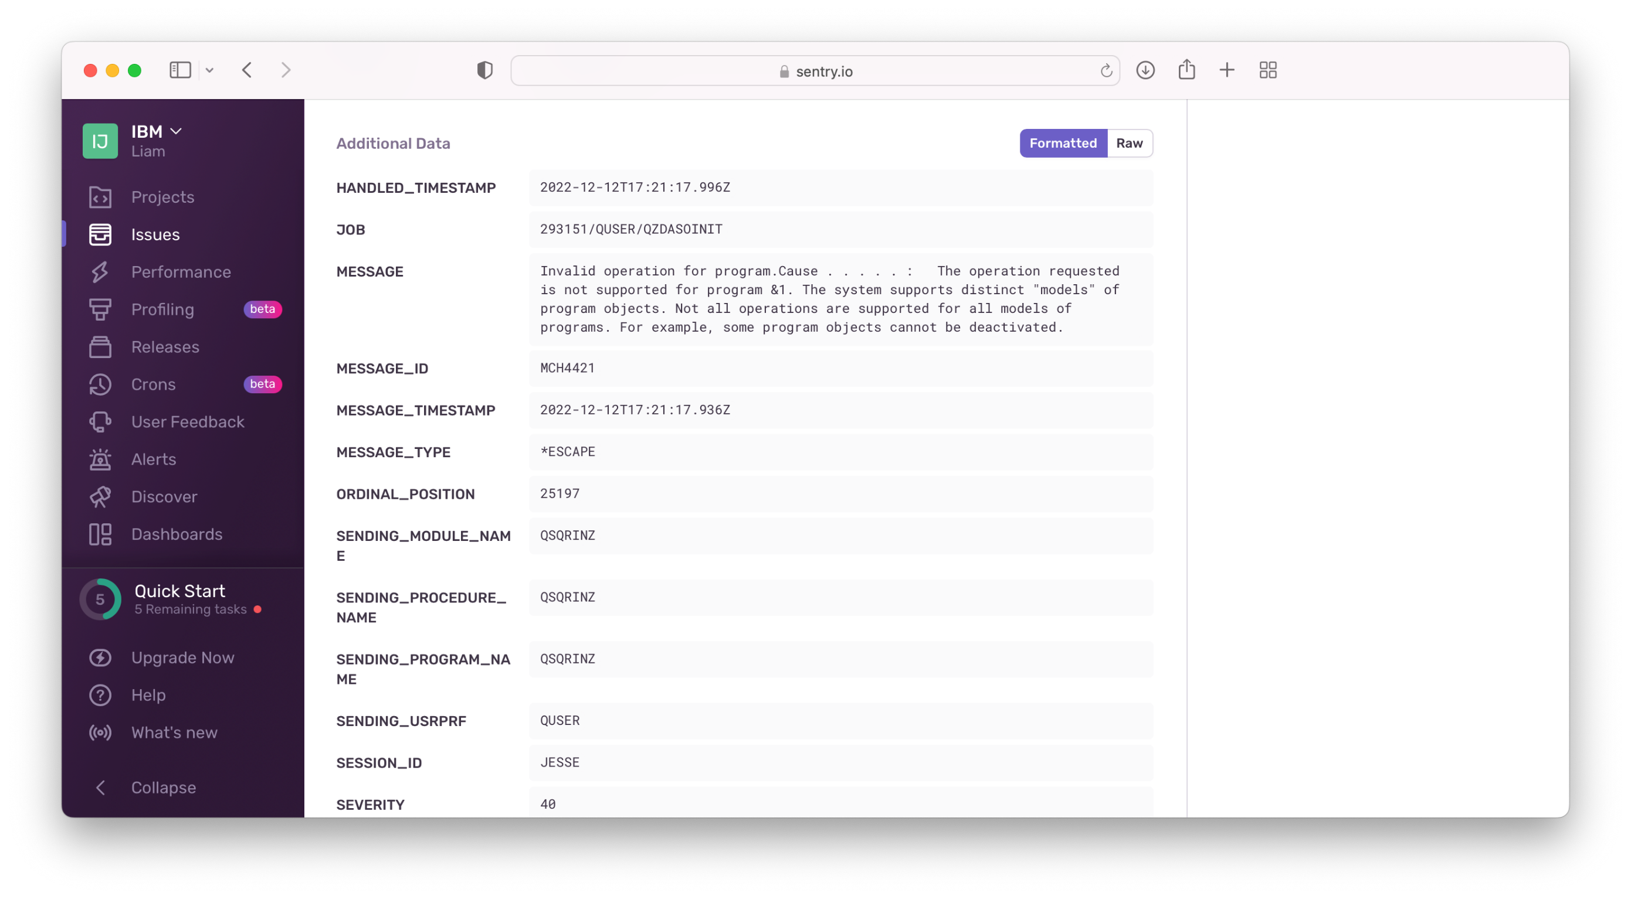
More examples…Sentry!

Slide 46
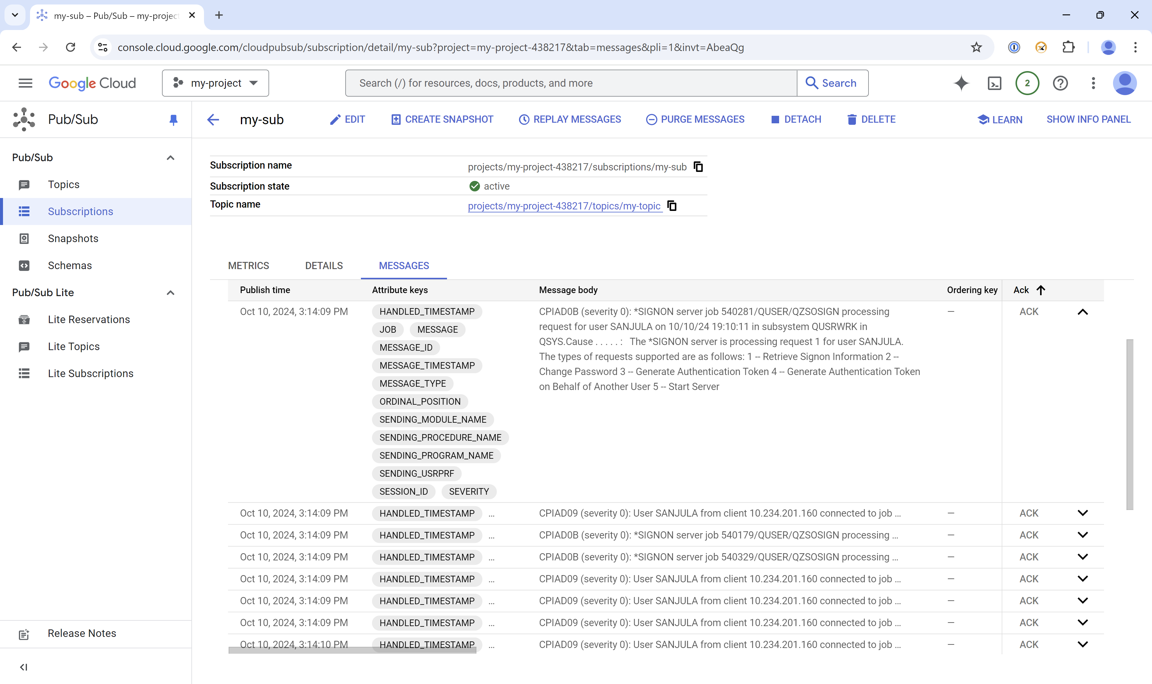
More examples…Google Pub/Sub!

Slide 47
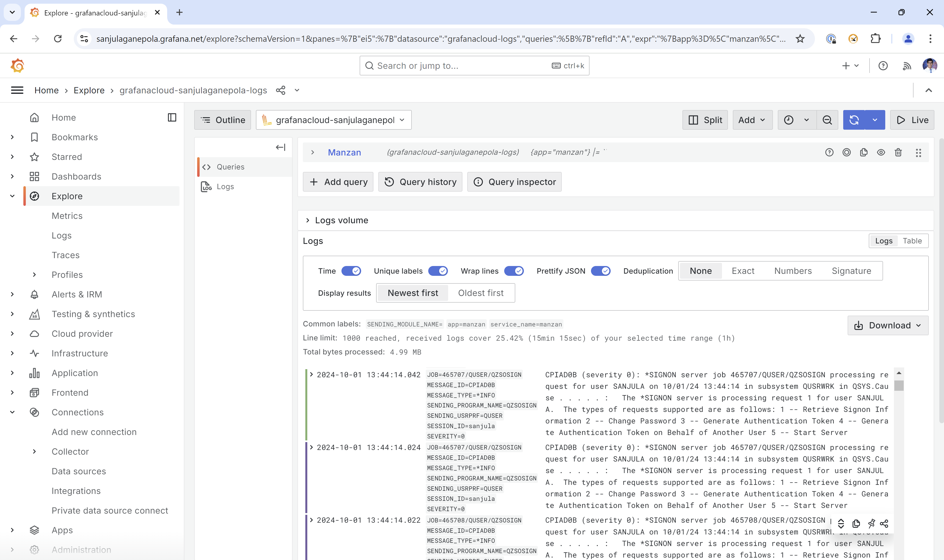
More examples…Grafana Loki!
Video Demo: https://www.youtube.com/watch?v=3XXjvkchCWc

Slide 48
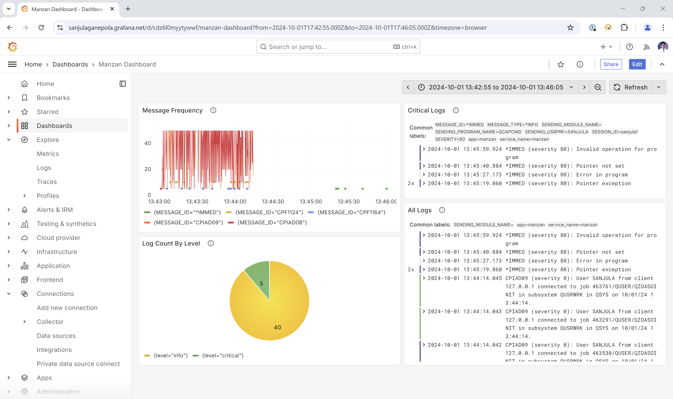
Visualize Logs in Grafana Dashboard

Slide 49
Future Enhancements to Manzan
System exit point processing
Metrics exported to Prometheus, for instance:
How many MCH exceptions have happened in production applications?
How many severity 40+ history log entries?
How many errors showing in web server logs?
How many PASE VLOGs have been created?
Ability to trigger events from Prometheus exporter, for instance:
Memory pool usage anomalies
Increased HTTP server traffic
Unexpected amount of remote connections
Operational data beyond thresholds

Slide 50
Manzan + AI

Slide 51
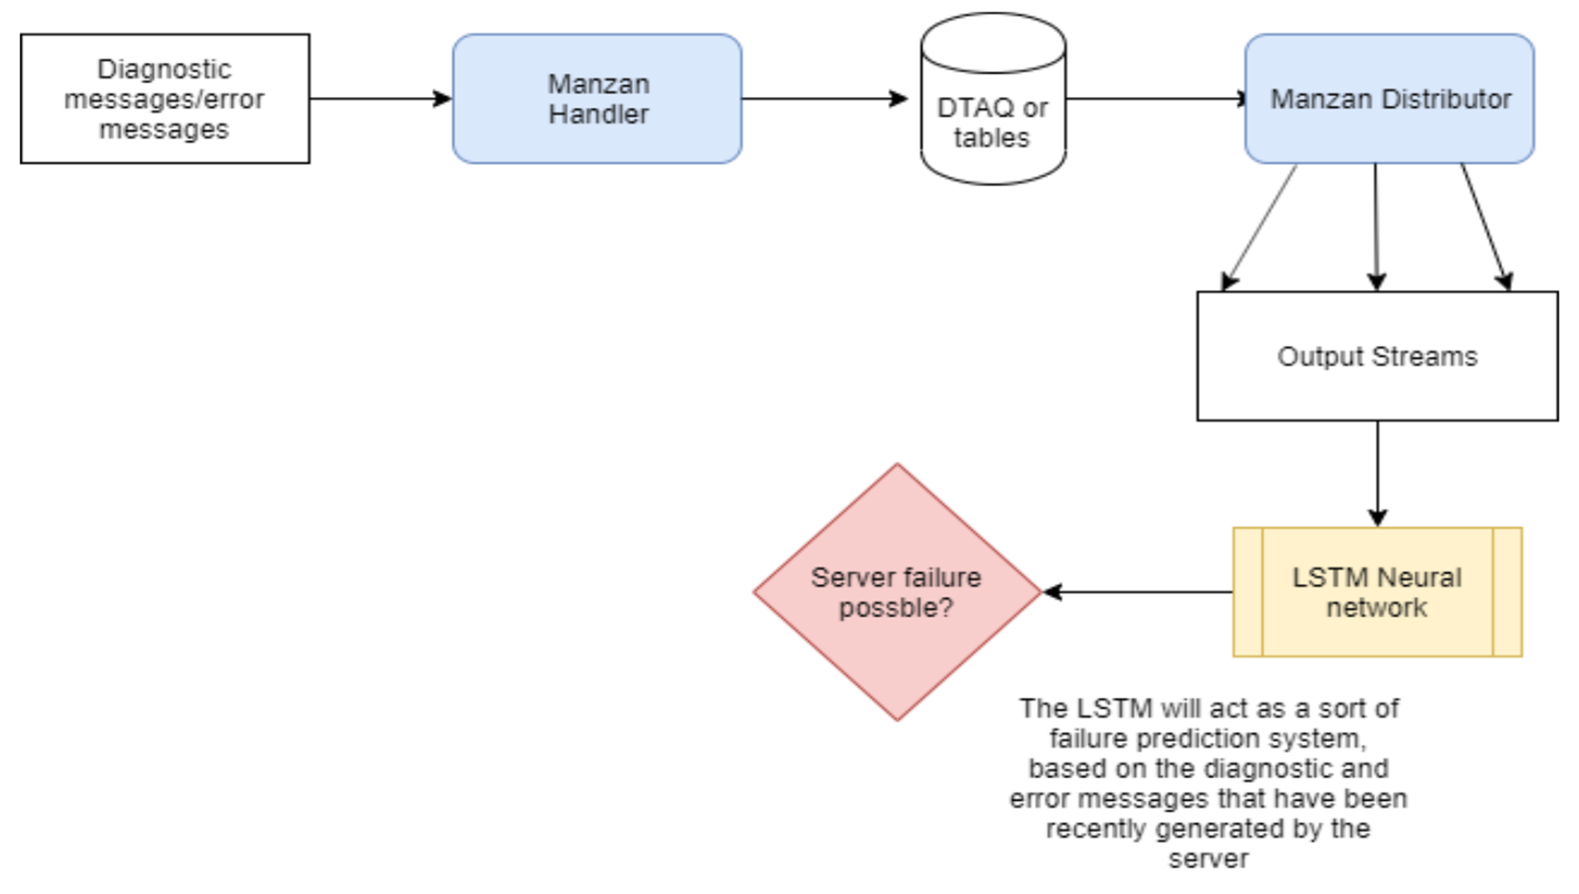
AI-Based System Monitoring: Failure Prediction System

Slide 52
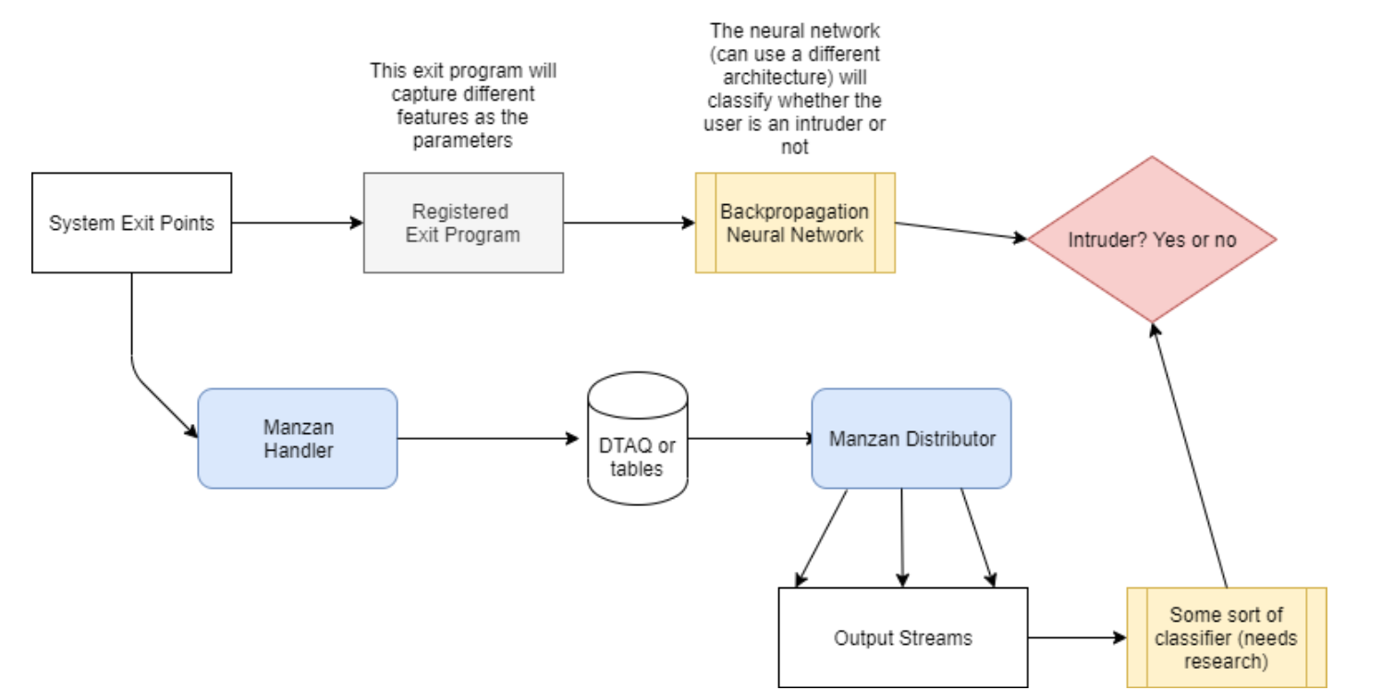
AI-Based System Monitoring: Intrusion Detection System

Slide 53
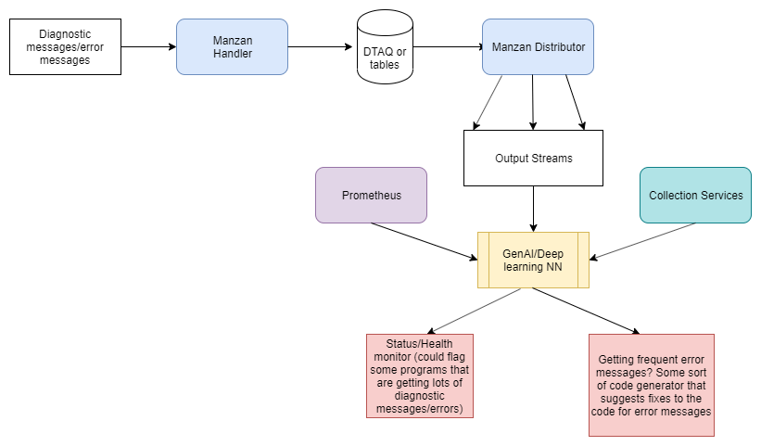
AI-Based System Monitoring: Health and Performance Assistant

Slide 54
Any Questions?

Slide 55

Sanjula Ganepola - OSS Tools For System Management
Please take the last minute of this session to complete the evaluation. A direct link to the evaluation can be found using the QR code to the right.

